Slide 1
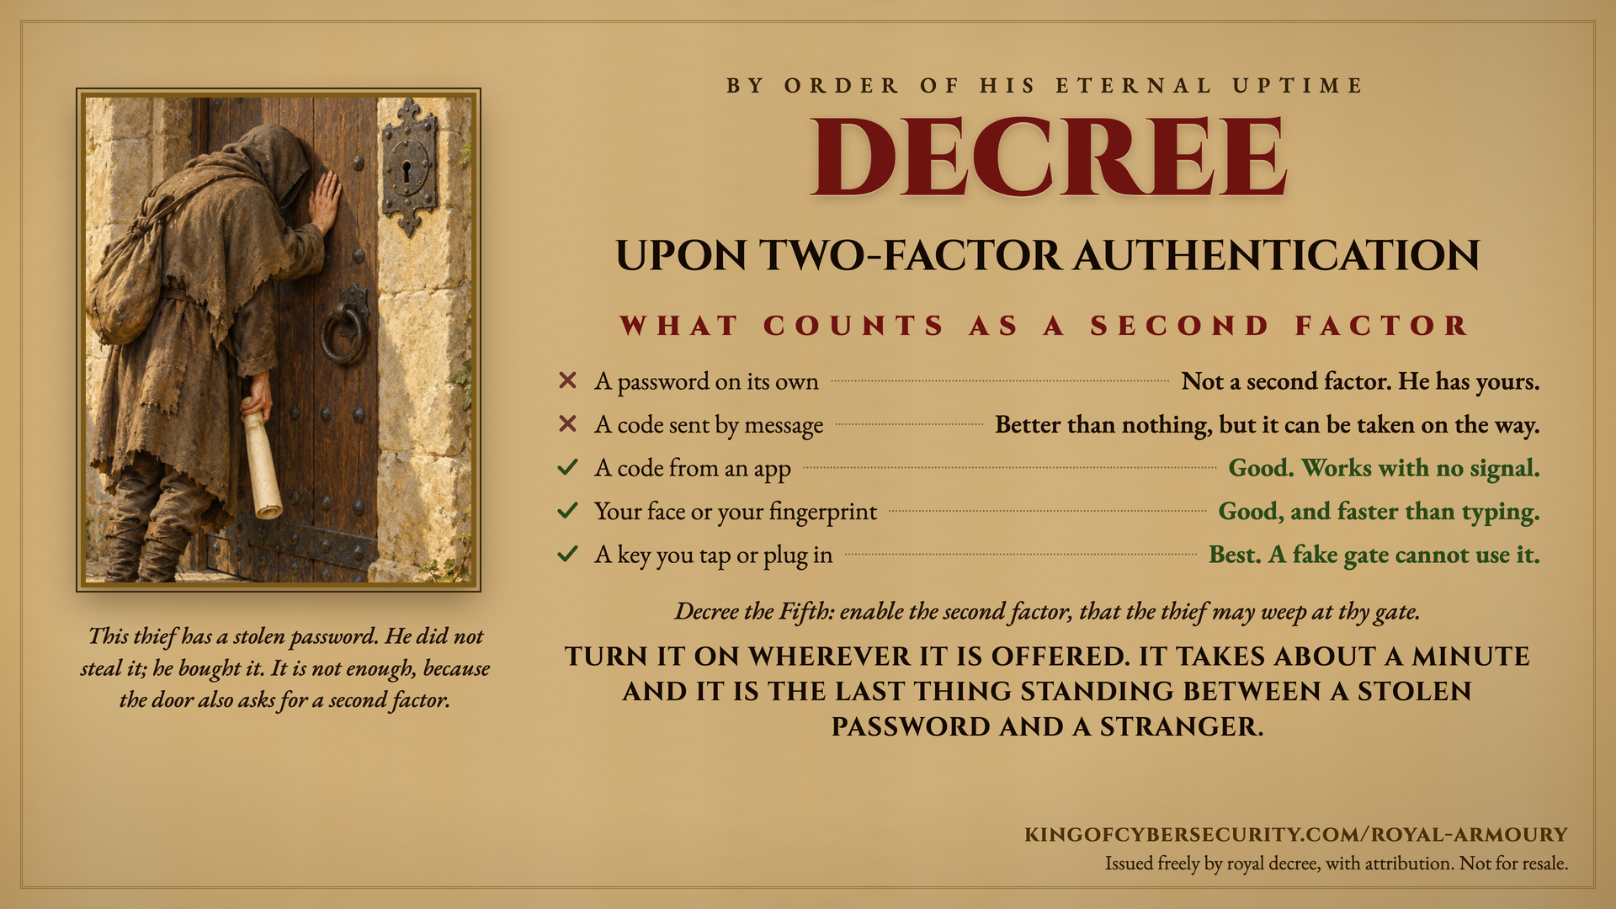
Notes:
Speaker notes, as supplied by the court. Every row on the record encodes current authentication guidance (NIST SP 800-63B, and the FIDO2/WebAuthn origin-binding property).
The one idea to land: the second factor is not there to keep your password secret. It is for after your password is already gone, which for most people it already is. The thief in the picture is not picking a lock. He has a working password and he is still outside.
- A password on its own is not a second factor at all. Credentials are stolen in bulk and traded as a commodity, so assume yours is out there rather than hoping it is not.
- A code sent by message is interceptable, by SIM swap and by attacks on the phone network, and NIST has restricted SMS as an out-of-band authenticator since 2017. Say the hedge out loud: this is far better than nothing, and nobody should switch SMS off because of this slide. It is the weakest of the working options, not a bad one.
- A code from an app is generated on the device from a shared secret and a clock, so it works with no signal at all: on a train, in a lift, abroad. Note what this row does not claim. An app code can still be typed into a convincing fake site.
- Your face or your fingerprint is device biometrics, which in practice usually unlocks a stored passkey. The honest sell here is speed: it is faster than typing anything.
- A key you tap or plug in takes the top place because it is the only phishing-resistant option on the list. The credential is bound to the real site's address, so a lookalike cannot use it even if the person is completely fooled.
What to say when someone asks what to do first: turn it on for email before anything else, then banking, then anything holding payment details. Email first, because it is the account that resets all the others.
If someone says it will slow them down: enrolment is about a minute per account, and most services then stop asking on a device they already know. The cost is one minute; the alternative is that a correct password is the only thing between a stranger and the account.
If someone asks why the logs would not catch it: they would not, and that is the point of the last line. A valid sign-in with a correct password does not look like an attack. The second factor stops it; the log only records it.
Attribution: kingofcybersecurity.com/royal-armoury. Free to use in awareness programmes, presentations, classrooms and newsletters, with attribution. Not for resale.

