Slide 1
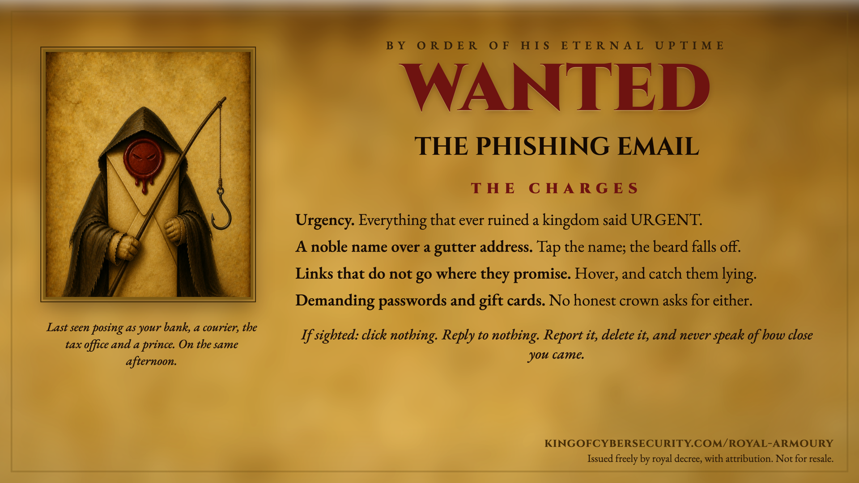
Notes:
Speaker notes, as supplied by the court.
The charges are real phishing indicators:
- Urgency: scammers manufacture deadlines because frightened people stop checking. Slowing down defeats the technique.
- Noble name, gutter address: tap or expand the sender's display name; the real address hides behind it.
- False links: hover on desktop, long-press on mobile, and preview the destination before clicking.
- Passwords and gift cards: no legitimate bank, tax office or helpdesk asks for either. The request itself is the tell.
If someone is caught by one: report it through your organisation's channel, delete it, change any password given away (everywhere it was reused) and enable two-factor authentication.
UK reporting: forward emails to report@phishing.gov.uk; forward scam texts to 7726.
This slide is issued free by kingofcybersecurity.com/royal-armoury, with attribution. Not for resale.

