Slide 1
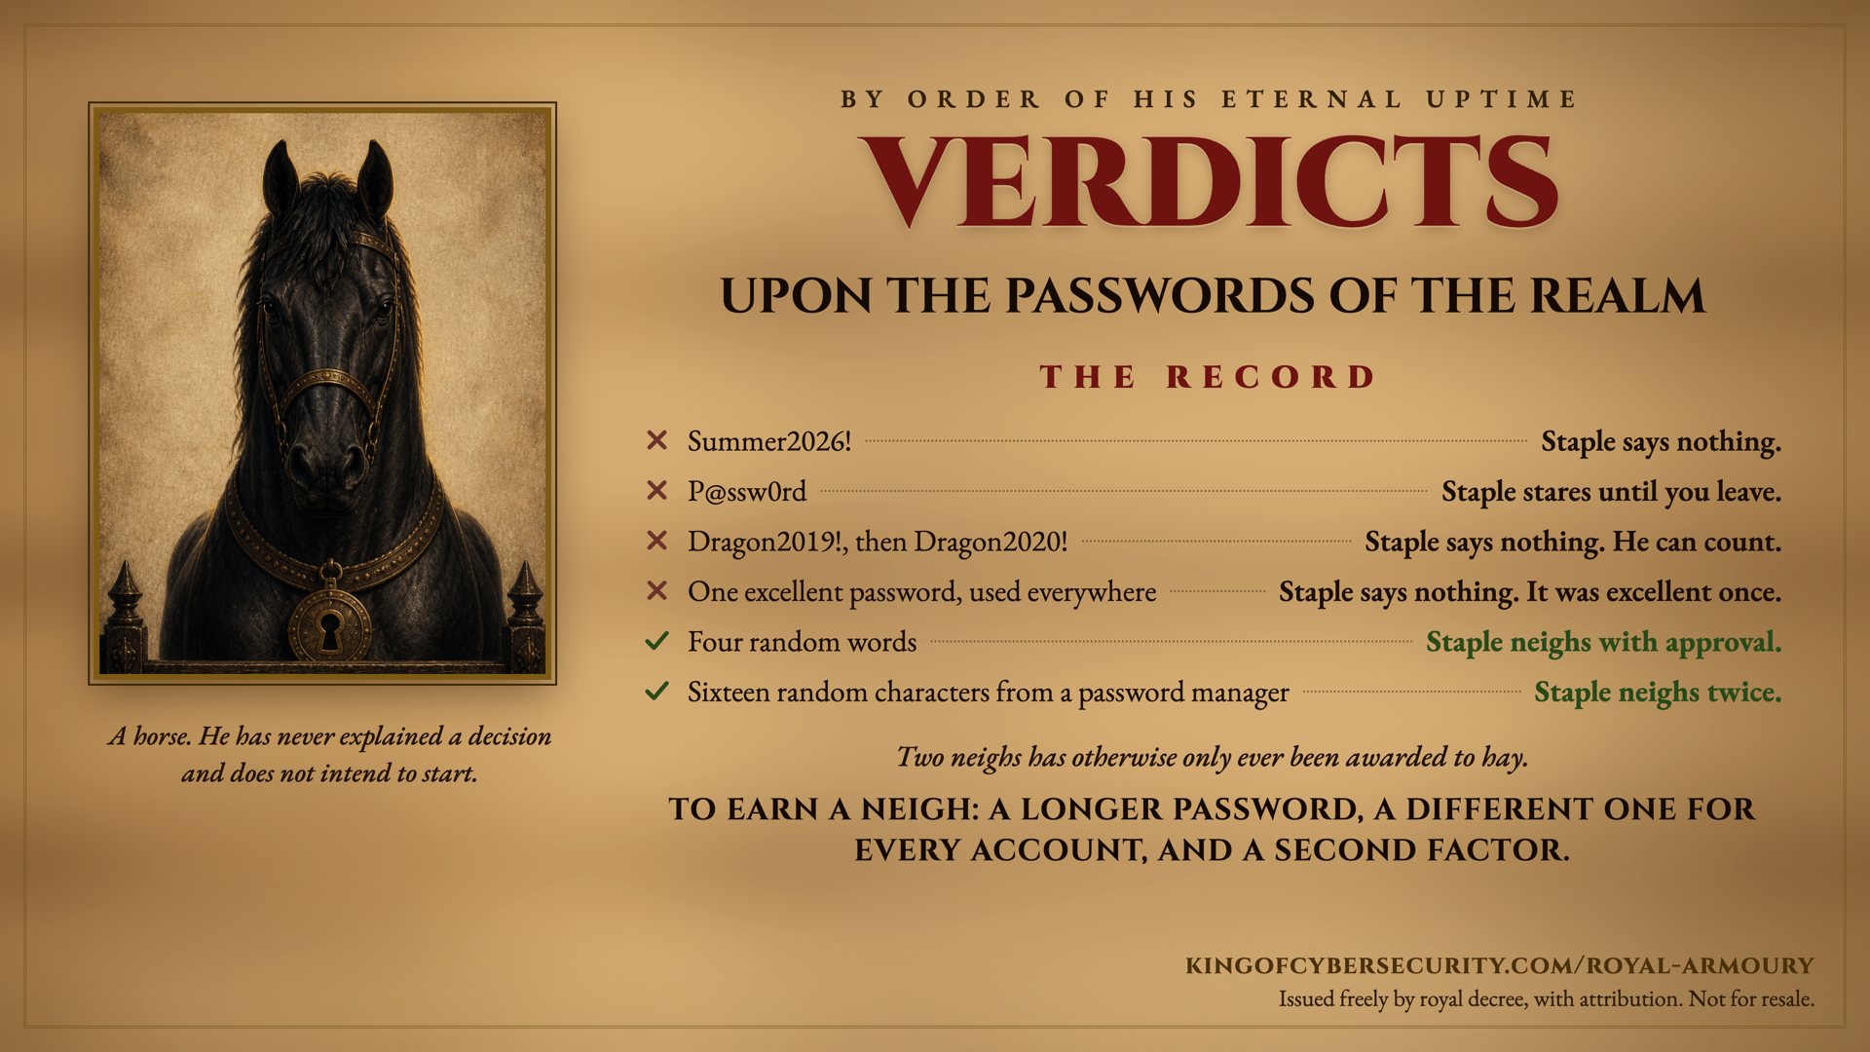
Notes:
Speaker notes, as supplied by the court. The record is a real one: every verdict encodes current password guidance (NIST SP 800-63B).
- Summer2026! passes a composition policy and fails reality. Predictable patterns are the first thing cracking tools try, and a capital plus a number plus a punctuation mark is the most predictable pattern there is.
- P@ssw0rd is "password" with substitutions, and every cracking dictionary already contains it. Character substitution buys nothing.
- Dragon2019! becoming Dragon2020! is not a new password. Note: this is not advice to stop rotating if your organisation requires it. It is advice that incrementing is not rotation.
- One excellent password used everywhere is what makes credential stuffing work. When any one site is breached, the attacker tries that pair everywhere else. Reuse turns one company's bad day into yours.
- Four random words is a passphrase: length beats complexity, and a human can actually remember it. Right for the few passwords you must keep in your head, such as your device login and the password manager's own master password.
- Sixteen random characters from a password manager takes the top honour because it is the only answer that scales. It makes them long, makes them different for every account, and remembers them so you do not have to.
What to say when someone asks what to do first: get a password manager, turn on a second factor for email and banking before anything else, and stop reusing. Email first, because it is the account that resets all the others.
Second factor, in plain terms: something beyond the password, such as an app code or a security key. An app or a key beats an SMS code, but an SMS code beats nothing at all.
If someone confesses to reusing a password that has since been breached: change it on the important accounts first (email, then banking, then anything holding payment details), and turn on the second factor while you are in there. haveibeenpwned.com will tell them which breaches their address has appeared in.
Attribution: kingofcybersecurity.com/royal-armoury. Free to use in awareness programmes, presentations, classrooms and newsletters, with attribution. Not for resale.

